Slide 1



Lumio English
LESSON
11
CLOTHES
shirt • dress • pants • shoes • hat • jacket • socks • T-shirt
LEVEL 1 · 8 NEW WORDS
Notes:
Welcome the class. Today: Clothes. Goal: I can name clothes and say what I am wearing..

Slide 2



Lumio English
Welcome to Lumio English
2 / 29
Hello, little star!
Teacher says:
"Hello! Today we learn 8 new words!"
Notes:
Warm greeting. Set a positive, energetic tone.

Slide 3


Lumio English
Today's Goals
3 / 29
By the end, you will:
1. Say 8 new words
2. I can name clothes and say what I am wearing.
3. Play games and earn stars
Notes:
Read goals aloud. Keep energy up.

Slide 4


Lumio English
Warm-up • Clothes
4 / 29
Let's get ready!
Stand up and stretch!
Say hello to a friend.
Clap your hands three times!
Notes:
2-3 minutes, high energy, physical movement.

Slide 5

Lumio English
Words for Today
5 / 29
8 new words
shirt — قميص
dress — فستان
pants — بنطال
shoes — حذاء
hat — قبعة
jacket — سترة
socks — جوارب
T-shirt — تي شيرت
Notes:
Preview words quickly. Don't teach yet, just build excitement.

Slide 6

Lumio English
Vocabulary • shirt
6 / 29
shirt
قميص
SAY IT
"It is a shirt."
Listen → Repeat ×3
Notes:
Model "shirt" x2, choral repeat x3. Meaning: قميص. Sentence: It is a shirt..

Slide 7

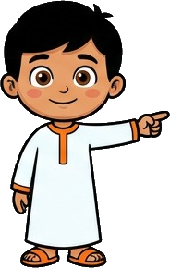
Lumio English
Practice • shirt
7 / 29
Can you say it?
"It is a shirt."
قميص
Notes:
Call on a student. Give first-sound hint if needed: "s..."

Slide 8


Lumio English
Vocabulary • dress
8 / 29
dress
فستان
SAY IT
"It is a dress."
Listen → Repeat ×3
Notes:
Model "dress" x2, choral repeat x3. Meaning: فستان. Sentence: It is a dress..

Slide 9
Lumio English
Practice • dress
9 / 29
Can you say it?
"It is a dress."
فستان
Notes:
Call on a student. Give first-sound hint if needed: "d..."

Slide 10
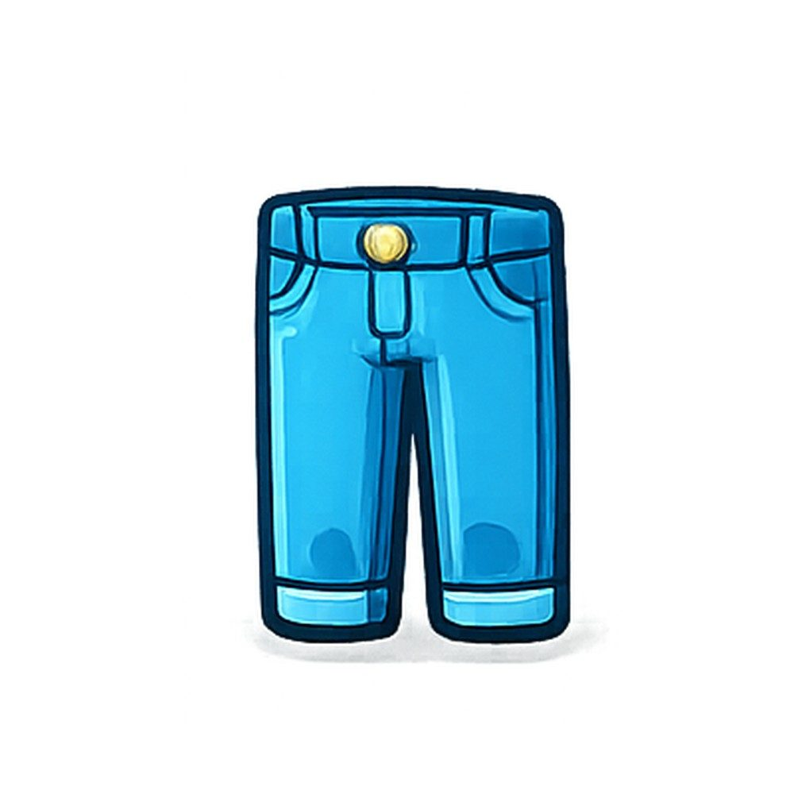

Lumio English
Vocabulary • pants
10 / 29
pants
بنطال
SAY IT
"These are pants."
Listen → Repeat ×3
Notes:
Model "pants" x2, choral repeat x3. Meaning: بنطال. Sentence: These are pants..

Slide 11
Lumio English
Practice • pants
11 / 29
Can you say it?
"These are pants."
بنطال
Notes:
Call on a student. Give first-sound hint if needed: "p..."

Slide 12
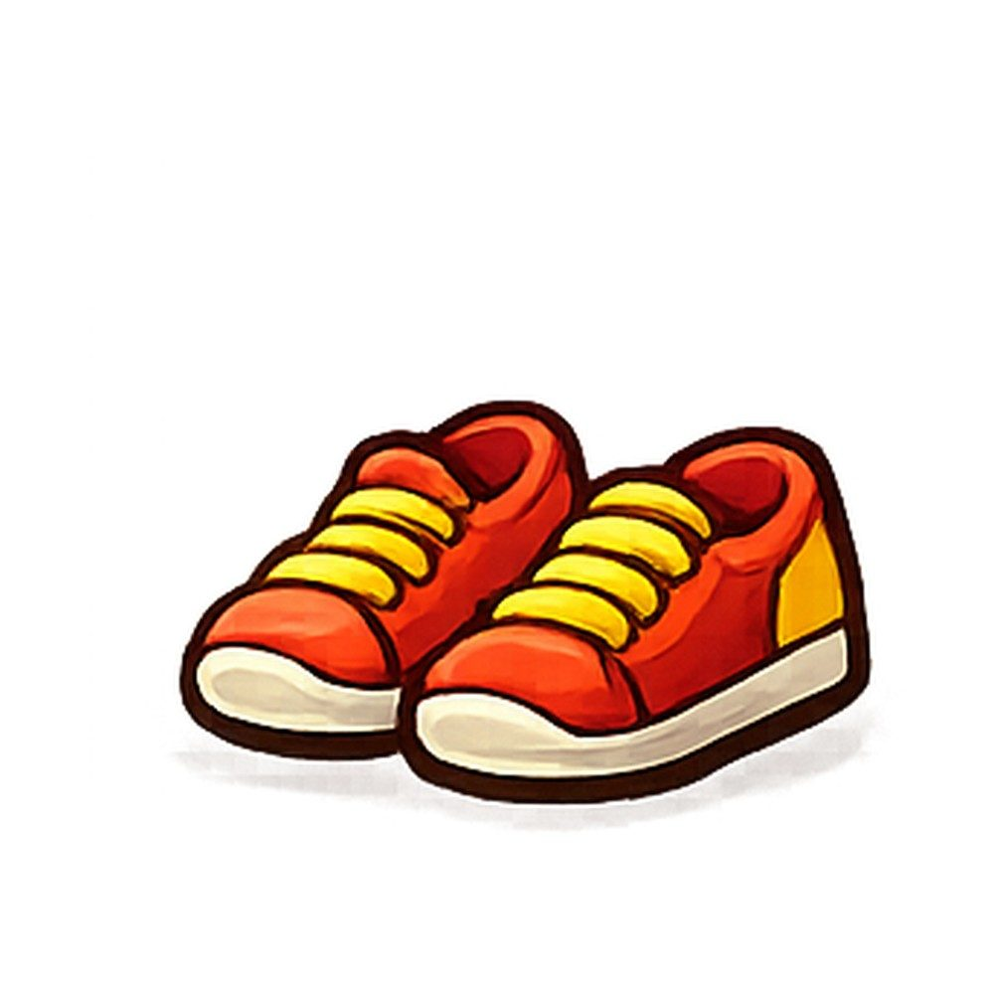
Lumio English
Vocabulary • shoes
12 / 29
shoes
حذاء
SAY IT
"These are my shoes."
Listen → Repeat ×3
Notes:
Model "shoes" x2, choral repeat x3. Meaning: حذاء. Sentence: These are my shoes..

Slide 13
Lumio English
Practice • shoes
13 / 29
Can you say it?
"These are my shoes."
حذاء
Notes:
Call on a student. Give first-sound hint if needed: "s..."

Slide 14
Lumio English
Vocabulary • hat
14 / 29
hat
قبعة
H
A
T
SAY IT
"It is a hat."
Listen → Repeat ×3
Notes:
Model "hat" x2, choral repeat x3. Meaning: قبعة. Sentence: It is a hat..

Slide 15
Lumio English
Practice • hat
15 / 29
Can you say it?
"It is a hat."
قبعة
Notes:
Call on a student. Give first-sound hint if needed: "h..."

Slide 16

Lumio English
Vocabulary • jacket
16 / 29
jacket
سترة
SAY IT
"It is a jacket."
Listen → Repeat ×3
Notes:
Model "jacket" x2, choral repeat x3. Meaning: سترة. Sentence: It is a jacket..

Slide 17
Lumio English
Practice • jacket
17 / 29
Can you say it?
"It is a jacket."
سترة
Notes:
Call on a student. Give first-sound hint if needed: "j..."

Slide 18

Lumio English
Vocabulary • socks
18 / 29
socks
جوارب
SAY IT
"These are socks."
Listen → Repeat ×3
Notes:
Model "socks" x2, choral repeat x3. Meaning: جوارب. Sentence: These are socks..

Slide 19
Lumio English
Practice • socks
19 / 29
Can you say it?
"These are socks."
جوارب
Notes:
Call on a student. Give first-sound hint if needed: "s..."

Slide 20

Lumio English
Vocabulary • T-shirt
20 / 29
T-shirt
تي شيرت
SAY IT
"It is a T-shirt."
Listen → Repeat ×3
Notes:
Model "T-shirt" x2, choral repeat x3. Meaning: تي شيرت. Sentence: It is a T-shirt..

Slide 21
Lumio English
Practice • T-shirt
21 / 29
Can you say it?
"It is a T-shirt."
تي شيرت
Notes:
Call on a student. Give first-sound hint if needed: "T..."

Slide 22

Lumio English
Listen and Repeat
22 / 29
My turn, your turn!
1. shirt
2. dress
3. pants
4. shoes
5. hat
6. jacket
7. socks
8. T-shirt
Notes:
Point and say each word, students repeat.

Slide 23
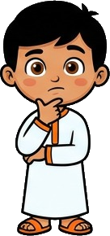
Lumio English
Your Turn • Round 1 of 3
23 / 29
What is this?
Notes:
Call a student by name. Answer: shirt (قميص). Hint if needed: "s..."

Slide 24
Lumio English
Your Turn • Round 2 of 3
24 / 29
What is this?
Notes:
Call a student by name. Answer: dress (فستان). Hint if needed: "d..."

Slide 25
Lumio English
Your Turn • Round 3 of 3
25 / 29
What is this?
Notes:
Call a student by name. Answer: pants (بنطال). Hint if needed: "p..."

Slide 26

Lumio English
Game • Quiz 1 of 2
26 / 29
Which word means "جوارب"?
A
B
C
dress
socks
jacket
Notes:
Answer: socks. Count down 5-4-3-2-1 for excitement.

Slide 27
Lumio English
Game • Quiz 2 of 2
27 / 29
Which word means "تي شيرت"?
A
B
C
socks
jacket
T-shirt
Notes:
Answer: T-shirt. Count down 5-4-3-2-1 for excitement.

Slide 28


Lumio English
Reward Time
28 / 29
Great job!
★ ★ ★ ★ ★
You earned 5 stars!
Play Lesson 11 online to keep your streak!
Notes:
Celebrate! Praise students by name if time allows.

Slide 29
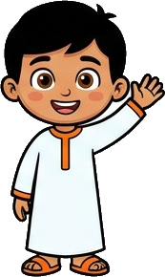
Lumio English
Homework & Goodbye
29 / 29
See you next time!
1. Play Lesson 11 on Lumio English
2. Say each word to your family
3. Earn your three stars!
Notes:
Assign homework. Warm goodbye.

